Slide 1
Content Marketing
Discover keywords that bring in more clients
We research and create a set of primary keywords that you should be including in your SEO strategy and give you keywords to help plan your content.
Do you know what content you should be writing?
Create blog topics that boost your SEO
Accelerate traffic to your blog with 100 new blog topics, content pipeline, keyword tracking, and trend optimisation to attract new visitors and generate more leads. If your competition is providing great content on a similar product or service then it only makes sense that they would be number one on Google.
Planning content is as important as writing content. We give you a set of 100 actionable topics that you can write to attract new clients to your blog.
Find out how your blog posts perform in Google
We track and report your main keywords in Google to see what page your blogs are in and to make sure you are writing content that gets searched by your ideal customers. We also check to see how many featured snippets you hold in the search results.
1

Slide 2
Content Marketing (continued)
Competitor Analysis:
We compare your domain metrics, content, backlinks, and keywords to three of your main competitors to see where you are being outperformed, and highlight the issues in a report for you to start climbing higher in the rankings.
Audit Summary
-100 blog topics - Ranking reports - 20 Target Keywords - 10 optimised blog topics - Competitor Analysis - Keyword Trend research - Featured snippet report - Content gap analysis (inc 2020)
Content Gap Analysis
Based on our keyword research, we will check how many supporting blogs you have on your website and cross check this with your competitors to highlight areas you need to improve on.
Google Trends:
We will identify any trends in your keywords to help you prioritise your content plan, and analyse the primary keywords in Google trends to see the last year's performance.
2

Slide 3
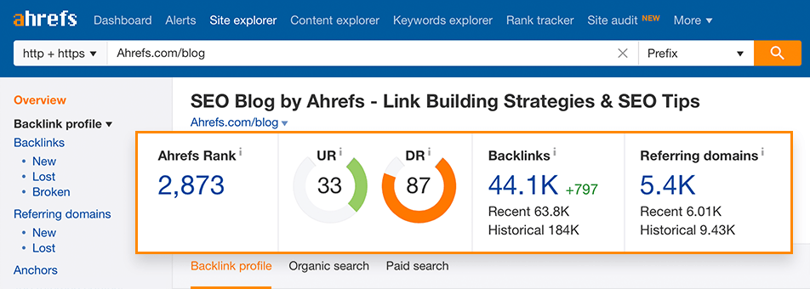
Backlink Audit
Who is really talking about you online?
Google looks at popularity when determining a webpage’s rankings, meaning if you have a low amount of websites that mention your articles, then your popularity is going to be low. The correct term for this is backlinks, and having great content is good, but you need backlinks to give you the best chance of getting those positions at the top of page one in a Google search.
1) Avoid Google penalties from spammy websites We manually check 1,000 websites from your profile to see if you have any unwanted links pointing to your website. We send a full report on the types of links you have, to give you an accurate number of how many good links and bad links lead to your website.
2) Health check and broken links We check for any hidden opportunities to repair broken backlinks. We give you a list of pages that are the top performing - and those that need improvement - to help you get better Google rankings.
3

